Slide 1

Software Process Models
Software Engineering
Lect-3

Slide 2
Software Process Models
A software engineer must incorporate a development strategy that encompasses the process methods, and tools layers.
This strategy is often referred to as a process model or a software engineering paradigm.
A process model is chosen based on the nature of project and application, the methods and tools to be used, and the controls and deliverables that are required.

Slide 3
Introduction to Software Process
Requirement acquisition (problem statements)
  to describe the problem to be solved and providing a conceptual overview of the proposed system
Requirement analysis
Requirement specification
System analysis
System design
Detail design
Coding
Testing
Maintenance

Slide 5
Requirement Analysis
A process of discovering, refinement, modeling and specification.
  Principles: represent information domain of a problem
    information flow: data & control changes
    information content: composite term.
    information structure: organization
  Modeling: (graphical & textual description)
    modeling methods: SA, OOA, JSD, DSSD, SADT
    model component: information, function, behavior

Slide 6
Requirement Analysis (cont’d)
  Artifact
    Requirement specification.
      capturing: functionality, behavior, and structure

Slide 7
Design
The problem is decomposed into modules
The interface between modules must be specified
Define architecture
Artifact: design model
  Data design
    data abstraction, data structure, data modeling
    Procedural design: iteration , conditional, sequence
    Architectural design: program structure, software architecture)

Slide 8
Implementation
Individual module programming
  Pseudo-code
The goals
  the development of a well-documented
  The reliable, easy to read, flexible, correct program
Integration of modules
Artifact: executable program

Slide 9
Testing
Test the system from requirement engineering to implementation
  Verification and validation
Artifact: testing report

Slide 10
Maintenance
Maintain the user satisfaction
  Repair errors, requirements changed or extended
Changes in both the system’s environment and user requirements are inevitable
  Maintenance = Evolution

Slide 11
Software Life Cycle
Waterfall model
Prototyping
Incremental model
Spiral model
Fourth-generation techniques
Unify process model
Automatic software synthesis

Slide 12
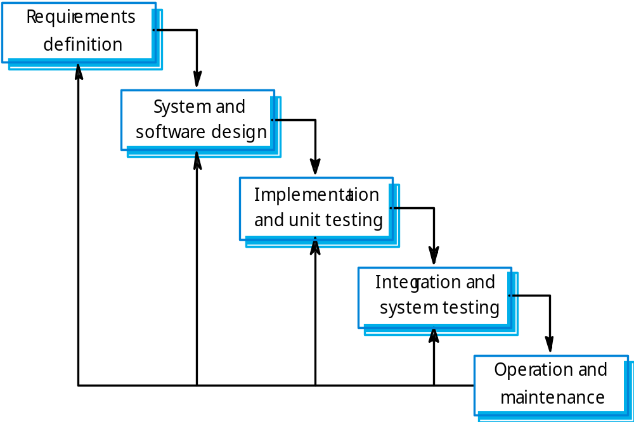
Waterfall model

Slide 13
Software Process Models: Waterfall
Advantages:
  Organized approach, provides robust separation of phases
  Reflects common engineering practice
Disadvantages:
  Doesn’t cope well with changes required by the client
  Development teams might wait for each other
  A working version of the product is available only late
Applicability:
  When requirements are well known and few changes are likely to be needed Can be used also for parts of larger software systems

Slide 14
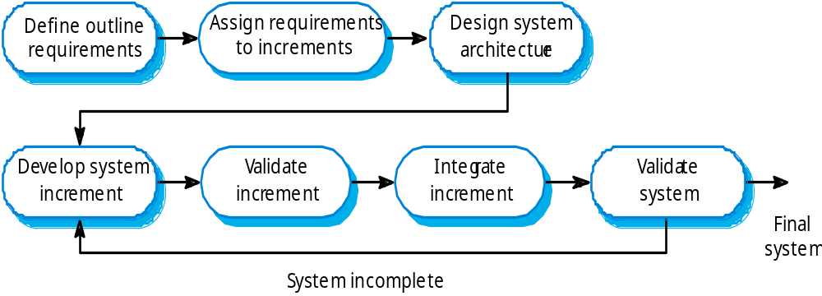
Incremental development

Slide 15
Incremental delivery
Rather than deliver the system as a single delivery, the development and delivery is broken down into increments with each increment delivering part of the required functionality.
User requirements are prioritised and the highest priority requirements are included in early increments.
Once the development of an increment is started, the requirements are frozen though requirements for later increments can continue to evolve.

Slide 16
Software Process Models: ..Incremental.
Advantages:
  Provides better support for process iteration
  Reduces rework in the software construction process
  Some decisions on requirements may be delayed
  Allows early delivery of parts of the system
  Supports easier integration of sub-systems
  Lower risk of project failure
  Delivery priorities can be more easily set

Slide 18
Software Process Models: ...Incremental
Disadvantages:
  Increments need be relatively small
  Mapping requirements to increments may not be easy
  Common software facilities may be difficult to identify
Applicability:
  When it is possible to deliver the system “part-by-part”

Slide 20
The RAD Model
Is a “high-speed” adaptation of the linear sequential model in which rapid development is achieved by using component-based construction.
Is an incremental software development process model that emphasizes an extremely short development cycle.

Slide 21
The RAD Model
Phases:
Business modeling
Data modeling
Process modeling
Application generation: 4GT
Testing and turnover

Slide 22
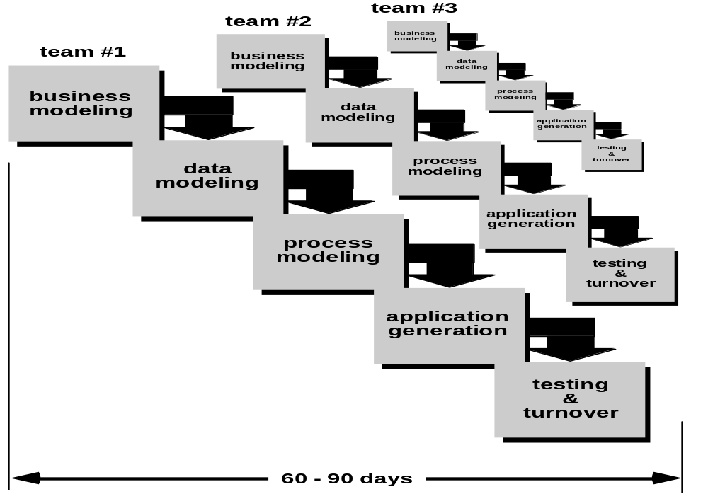
RAD Model
RAD

Slide 23
The RAD Model
Drawbacks:
RAD requires sufficient human resources to create the right number of RAD team, for a large project.
RAD requires strong commitment from developers and customers in much abbreviated time frame.
A system must be properly modularized.
RAD is not appropriate when technical risks are high.

Slide 24
When to use RAD
Reasonably well-known requirements
User involved throughout the life cycle
Project can be time-boxed
Functionality delivered in increments
  High performance not required
  Low technical risks
System can be modularized

Slide 25
Evolutionary Software Process Model
Business and product requirements often change as development proceeds.
Tight market deadlines, etc..

Slide 26
The Prototyping Model
The prototype can serve as “the first system”
Users get a feel for the actual system and developers get to build something immediately
A customer defines a set of general objectives for SW but does not identify detailed input, processing, or output requirements.

Slide 27
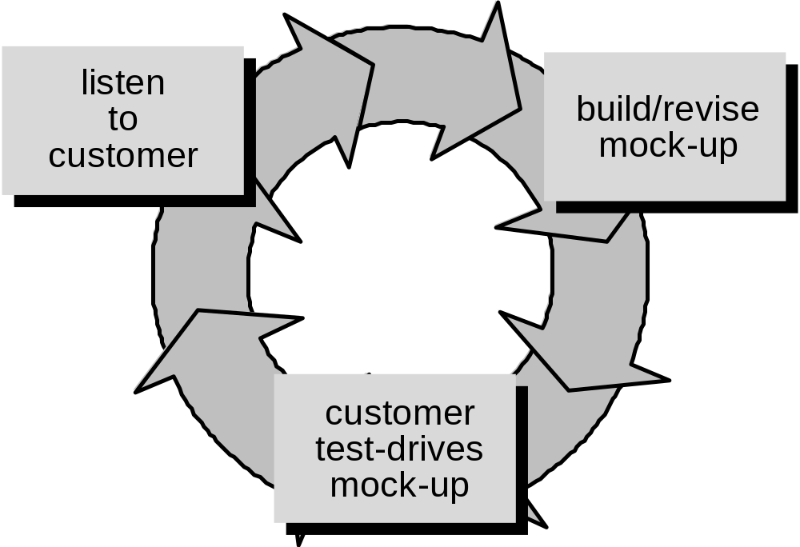
Prototyping Model
Prototyping

Slide 28
The Prototyping Model
This approach can be problematic:
The customer misunderstands as a working version with a few fixes.
The developer often makes implementation compromises in order to get a prototype to work quickly.
→ The customer and developer must agree that the prototype is built to serve as a mechanism for defining requirements.

Slide 29
Spiral Model
Proposed by Boehm.
It provides the potential for rapid development of incremental versions of the software.
A spiral model is divided into a number of framework activities, also called task regions.
Each of the regions is populated by a set of work tasks, called a task set.

Slide 30
Spiral Model
Proposed by Boehm.
It provides the potential for rapid development of incremental versions of the software.
A spiral model is divided into a number of framework activities, also called task regions.
Each of the regions is populated by a set of work tasks, called a task set.

Slide 31
Spiral Model
Since end-user requirements are hard to
obtain/define, it is natural to develop
software in an experimental way: e.g.
Build some software
See if it meets customer requirements
If no goto 1 else stop.

Slide 32
This loop approach gives rise to structured
iterative lifecycle models.
In 1988 Boehm developed the spiral model as an iterative model which includes risk analysis and risk management.
Key idea: on each iteration identify and solve the sub-problems with the highest risk.

Slide 33
Cumulative cost
Evaluate alternatives,
Identify & resolve risks
Determine objectives,
alternatives & constraints
Prototypes
Operational
Prototype
Review &
commitment
Start
P1
P2
P3
Requirements
plan
Concept
Of Operation
Design,
Validation
& Verification
Detailed design
Development
plan
Requirements
validation
Coding
Integration &
Test plan
Unit & Integration
Testing
End
Acceptance
Testing
Develop & verify
next-level product
Plan next phase

Slide 34
Spiral Quadrant
Determine objectives, alternatives and constraints
Objectives: functionality, performance, hardware/software interface, critical success factors, etc.
Alternatives: build, reuse, buy, sub-contract, etc.
Constraints: cost, schedule, interface, etc.

Slide 35
Spiral Quadrant
Evaluate alternatives, identify and resolve risks
Study alternatives: relative to objectives and constraints
Identify risks :lack of experience, new technology, tight schedules, poor process, etc.
Resolve risks :evaluate if money could be lost by continuing system development

Slide 36
Spiral Model Strengths
Provides early indication of insurmountable risks, without much cost
Users see the system early because of rapid prototyping tools
Critical high-risk functions are developed first
Early and frequent feedback from users
Cumulative costs assessed frequently

Slide 37
Spiral Model Weaknesses
Time spent for evaluating risks too large for small or low-risk projects
Time spent planning, resetting objectives, doing risk analysis and prototyping may be excessive
The model is complex
Risk assessment expertise is required
Spiral may continue indefinitely
May be hard to define objective, verifiable milestones that indicate readiness to proceed through the next iteration

Slide 38
When to use Spiral Model
When creation of a prototype is appropriate
When costs and risk evaluation is important
For medium to high-risk projects
Long-term project commitment
Users are unsure of their needs
Requirements are complex
New product line
Significant changes are expected (research and exploration)

Slide 39
Component-Based Development
OO technologies provide the technical framework for a component-based process model for SE.
The process to apply when reuse is a development objective.

Slide 40
COTS
COTS = Commercial Off-The-Shelf software
Engineer together a solution from existing commercial software packages using minimal software ”glue”.
E.g. using databases, spread sheets, word proccessors, graphics software, web browsers, etc.

Slide 41
Advantages
Fast, cheap solution
May give all the basic functionality
Well defined project, easy to run
Disadvantages
Limited functionality
Licensing problems, freeware, shareware, etc.
License fees, maintainance fees, upgrade
compatibility problems

Slide 42
UML class diagram!
Use Case Model
specified by
realised by
Analysis Model
deployed by
implemented by
Design Model
verified by
Deployment Model
Implementation Model
All models are interdepedent
but this only shown for use
case model
Test Model

